Slide 1
DEADLOCKS Resources Introduction To Deadlocks The Ostrich Algorithm Deadlock Detection & Recovery

Slide 2
Review
Memory-Mapped I/O
Map all the control registers into the memory space
Each control register is assigned a particular and unique memory address
DMA
A memory address register
A byte count register
One or more control registers
3 modes: Word-at-a-time, Block, Fly-by
Precise vs. Imprecise Interrupt
Precise: Leave the machine in a well-defined state
PC is saved in a known place
All instructions before the one pointed to by the PC have fully executed
No instruction beyond the one pointed to by the PC has been executed
Execution state of the instruction pointed to by the PC is known
Imprecise: Does not meet all requirements as precise

Slide 3
Review
I/O Software
Goals
Device Independent, Error handling, Synchronous vs. Asynchronous, Buffering, Dedicated device allocation
I/O with DMA
Layers
User level I/O software: pooling with daemon scheduling (Asynchronous)
Device independent
Uniform naming, Uniform interface, Independent block size
Buffering
Error handling, Dedicated device allocation
Device Drivers: help OS control specified devices depending on standard interface
Interrupt Handlers: handle interrupt to determine what the system should do

Slide 4
Review
Disk arm scheduling
Seek time
FCFS: Process request sequentially tuần tự công việc nào tới trước sẽ được xử lý trước
SSF: the least movement of the disk arm from its current head position
Elevator
Approach: Arm moves in one direction only, satisfying all outstanding requests until it reaches the last track in that direction
Implementation: When the highest numbered cylinder with a pending request has been services, the arm goes to lowest number cylinder with a pending request and then continues moving in an upward direction
Rotational delay
If two or more requests for the same cylinder are pending, the driver can issue a request for the sector that will pass under the head next
The OS should maintain a pending request table for each drive, a seek should be issued to move its arm to the cylinder where it will be needed next
Actual data transfer time (SATA)

Slide 5
Review
Disk arm scheduling
Error handling
Bad sector
Sectors do not correctly read back the value just written to them
Controllers remap the bad sector to the spare and/or Shift all the sectors up one
OS must first acquire a list of bad sectors, then it can build remapping tables
Seek errors
Move the arm as far out as it will go and reset the controller’s internal idea of the current cylinder to 0

Slide 6
Review
Disk arm scheduling
Disk Consistency
Stable write: Write block on drive 1, then reading it back to verify. The driver 2 is written and reread until it succeeds
Stable read: First read block on drive 1 in n times. If all of these give bad ECCs, reading on drive 2
Crash recovery: scans both disks comparing corresponding blocks. Bad block is overwritten with the good blocks or block from driver 1 is written onto drive 2
Optimizing: using Nonvolatile/ Volatile RAM to replace in using driver 2
Thin Client
Power Manager
The programs to use less energy, even if this means providing a poorer user experience
Display, HDD, CPU, Memory, Wireless, Driver Interface

Slide 7
Review
Clocks
02 types
Using volt power
a crystal oscillator, a counter, and a holding register
2 modes: one shot mode, square wave mode
Functions
Maintaining the time of day (real time).
Preventing processes monopolizing CPU
Accounting for CPU usage
Handling alarm system call
Providing watchdog timers
Doing profiling, monitoring, statistics gathering
User Interfaces
Input software (Keyboard software: scan code, echoing, tab handling, device equivalent
Output software (Text window, X Window, GUI, Bitmaps, Fonts)
Mouse software

Slide 8
Objectives
Resources
Preemptable and Nonpreemptable Resources
Resource Acquisition
Introduction To Deadlocks
Conditions for Resource Deadlocks
Deadlock Modeling
The Ostrich Algorithm
Deadlock Detection & Recovery
Deadlock Detection with One Resource of Each Type
Deadlock Detection with Multiple Resources of Each Type
Recovery from Deadlock

Slide 9
Overviews
Context
Computer systems are full of resources that can only be used by one process at a time
All OS have the ability to (temporarily) grant a process exclusive access to certain resources
A process needs exclusive access do not one resource, but several
A set of blocked processes each holding a resource and waiting to acquire a resource held by another process in the set, thus they will remain so forever (deadlocks).
Deadlock does not occur only on local machine but also across machines
Deadlocks can occur in a variety of different situations such as requesting dedicated I/O devices, on hardware or software resources

Slide 10
Resources
Refer the objects as hardware devices, data records, files, etc .. that must be granted, acquired, used and released
A computer will normally have many different resources
Some resource is the identical instances may be available
Some resource is copied of a resource available
There are two type resources
Preemptable
Nonpreemptable

Slide 11
Resources
Preemptable
Is resources that can be taken away from the process owning it with no ill effects (either on system or others)
Preemptable resources can be resolved deadlocks by reallocating resources from one process to another
Ex:
A system with 256 MB of user memory, one printer, and two of 256 MB processes that each want to print some thing
Process A requests and gets the printer, then starts to compute the values to print. Before it has finished with the computation, it exceeds its time quantum and is swapped out (Process A has the printer, but it locates on disk)
Process B now runs and tries, unsuccessfully to acquire the printer (Process B locates on memory, but it cannot access the printer)
→ Process A take away the B’s memory by swapping process B out & swapping process A in. After finished, process A releases both

Slide 12
Resources
Nonpreemptable
Is resources that cannot taken away from its current owner without causing the computation to fail
Ex
If the process has begun to burn ghi vào ổ đĩa a CD-ROM, suddenly taking the CD recorder away from it and giving it to another process will result in a garbled CD
Deadlocks involve nonpreemptable resources

Slide 13
Resources
Resource Acquisition
The sequence of events required to use resource
Request the resource
Use the resource
Release the resource
One of way allowing user manager of resources is to associate a semaphore with each resource
The semaphores are all initialized to 1
A down to acquire the resource, using the resource
A up on the resource to release resource

Slide 14
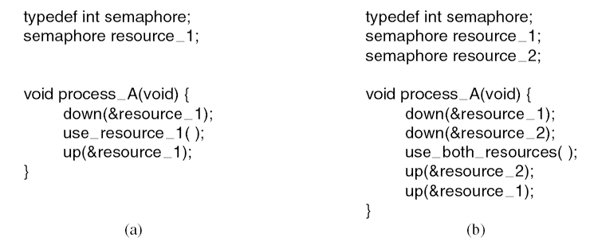
Resources
Resource Acquisition
Tanenbaum, Fig. 6-1.

Slide 15
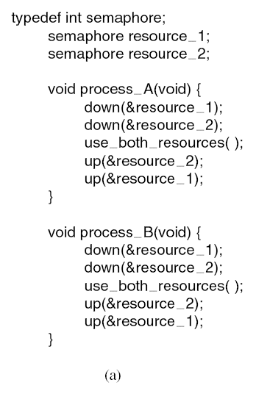
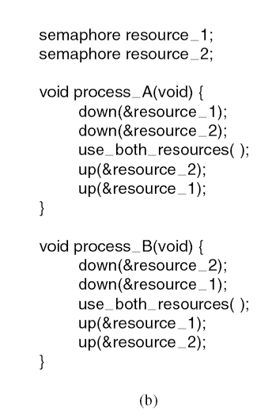
Resources
Resource Acquisition
Deadlock
Tanenbaum, Fig. 6-2.

Slide 16

Introduction to Deadlocks
A set of processes is deadlocked if each process in the set is waiting for an event that only another process in the set can cause
None of processes can run
None of them can release any resources
None of them can be awakened
→ All the processes continue to wait forever
Assume
Processes have only a single thread and
There are no interrupts possible to wake up a blocked processes

Slide 17
Introduction to Deadlocks
Conditionals for Resource Deadlocks
Resource Deadlocks
A resource that is owned by a deadlocked process
Four conditions must hold for there to be a deadlock
Mutual exclusion condition
Each resource is either currently assigned to exactly one process or is available
Hold and wait condition.
A process currently holding at least one resource is waiting to acquire additional resources held by other processes
No preemption condition.
A resource can be released only voluntarily by the process holding it, after that process has completed its task
Circular wait condition
There must be a circular chain of two or more process, each of which is waiting for a resource held by the next member of chain

Slide 18




Introduction to Deadlocks Deadlock Modeling
Four conditions for resource deadlocks can be modeled using directed graphs (Holt – 1972)
The graphs have two kinds of nodes
Processes that are shown as circles
Resources that are shown as squares
A directed arc from a resource to process
The process is holding an instance of resource
A directed arc from a process to resource
The process is currently blocked and requests instance of resource
Tanenbaum, Fig. 6-3.

Slide 19
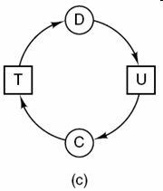
Introduction to Deadlocks
Deadlock Modeling – Examples
Tanenbaum, Fig. 6-3

Slide 20
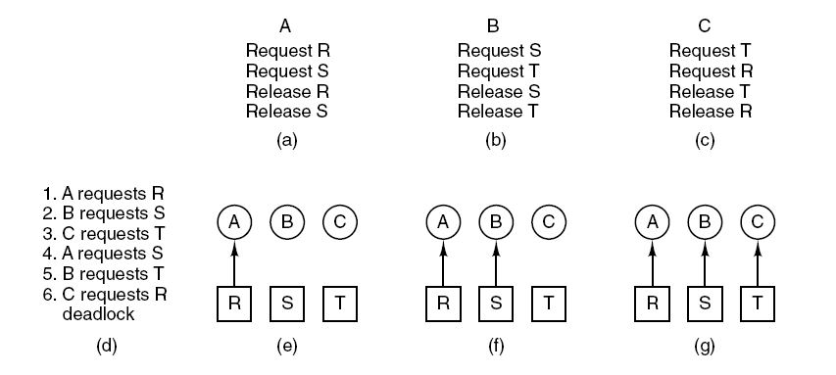
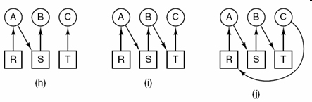
Introduction to Deadlocks Deadlock Modeling – Examples
Tanenbaum, Fig. 6-4.

Slide 21
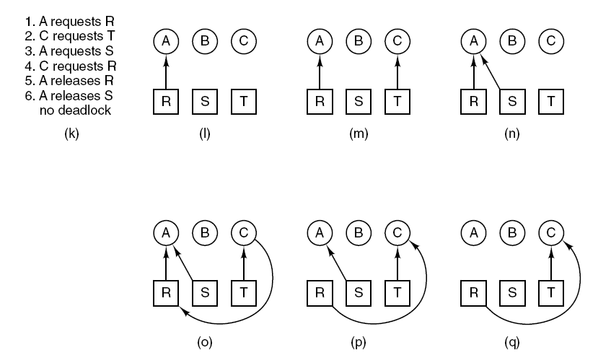
Introduction to Deadlocks Deadlock Modeling – Examples
Tanenbaum, Fig. 6-4

Slide 22
Introduction to Deadlocks
Deadlock Modeling
Resource graphs are a tool that
Let see of a given request/ release request sequence leads to deadlock
Help carrying out the requests and releases step by step, and after every step check the graph to see if it contains any cycles to check deadlock or not
Can generalized to handle either single resource or multiple resource
Basic facts
If graph contains no cycles → no deadlock
If graph contains a cycle
If only one instance per resource type, then deadlock
If several instances per resource type, possibility of deadlock

Slide 23
Introduction to Deadlocks Deadlock Modeling
Strategies for dealing with deadlocks
Just ignore the problem
Maybe if you ignore it, it will ignore you
Detection and recovery.
Let deadlocks occur, detect them, take action.
Dynamic avoidance by careful resource allocation.
Prevention, by structurally negating one of the four required conditions

Slide 24
The Ostrich Algorithms
Just ignore the problem
Stick your head in the sand and pretend is no problem at all
Different people react in different ways
Mathematicians
Totally unacceptable and must prevent deadlocks at all costs
Engineers
Would not be willing pay a large penalty in performance or convenience to eliminate deadlocks
OS blocks caller that requests the busy device
The device driver decide blocking or returning an error code

Slide 25
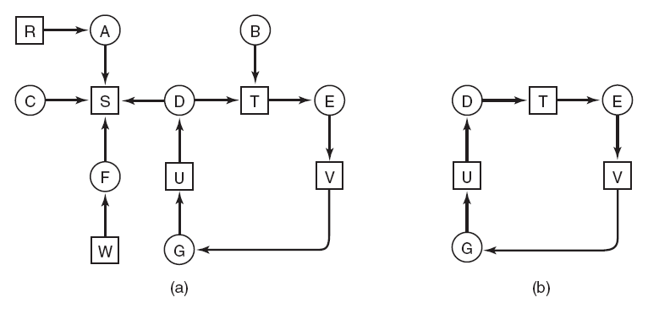
Deadlock Detection & Recovery Deadlock Detection with One Resource of Each Type
Tanenbaum, Fig. 6-5.

Slide 26
Deadlock Detection & Recovery Deadlock Detection with One Resource of Each Type
Algorithm for detecting deadlock:
For each node, N in the graph, perform the following five steps with N as the starting node.
Initialize L to the empty list, designate all arcs as unmarked.
Add current node to end of L, check to see if node now appears in L two times. If it does, graph contains a cycle (listed in L), algorithm terminates.
From given node, see if any unmarked outgoing arcs. If so, go to step 5; if not, go to step 6.
Pick an unmarked outgoing arc at random and mark it. Then follow it to the new current node and go to step 3.
If this is initial node, graph does not contain any cycles, algorithm terminates. Otherwise, dead end. Remove it, go back to previous node, make that one current node, go to step 3

Slide 27
Deadlock Detection & Recovery Deadlock Detection with Multiple Resource of Each Type
A matrix-based algorithm among n processes, P₁ through P_{n} and m resource classes, E₁ through E_{m}
Let E be the existing resource vector that gives the total number of instance of each resource in existence
Let A be the available resource vector, with A_{i} giving the number of instances of resource i that are current available/ unsigned
Let C be the current allocation matrix, with
The i-th row of C tells how many instances of each resource class P_{i} currently holds
C_{ij} is the number of instances of resource j that P_{i} holds
Let R be the request matrix, with
The i-th row of P tells how many instances of each resource class P_{i} currently wants
R_{ij} is the number of instances of resource j that P_{i} wants

Slide 28
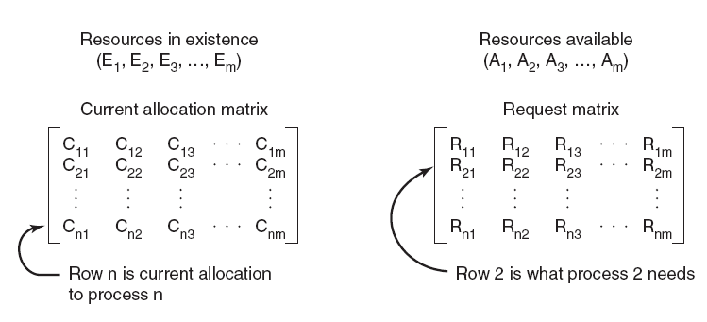
Deadlock Detection & Recovery Deadlock Detection with Multiple Resource of Each Type
Tanenbaum, Fig. 5-46.

Slide 29
Deadlock Detection & Recovery Deadlock Detection with Multiple Resource of Each Type
Each process is initially said to be unmarked
Deadlock detection algorithm
Look for an unmarked process, P_{i}, for which the R_{i} is less than or equal to A.
If such a process is found, add C_{i} to A, mark the process, and go back to step 1.
If no such process exists, the algorithm terminates
As the algorithm progresses, processes will be marked, indicating that they are able to complete and are thus not deadlocked
When the algorithm terminates, any unmarked processes are known to be deadlocked
This algorithm assumes a worst-case scenario: all processes keep all acquired resources until they exit

Slide 30
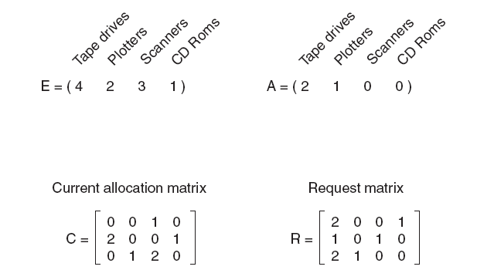
Deadlock Detection & Recovery Deadlock Detection with Multiple Resource of Each Type
No Process deadlock
Progress: 3, 2, 1
Process 1, 2 deadlock
Progress: 3
2 1 0 1
Tanenbaum, Fig. 6-7.

Slide 31
Deadlock Detection & Recovery Deadlock Detection with Multiple Resource of Each Type
No Process deadlock

Slide 32
Deadlock Detection & Recovery Deadlock Detection with Multiple Resource of Each Type
Process 2, 3, 4, 5 deadlock

Slide 33
Deadlock Detection & Recovery Recovery from Deadlock
Recovery through Preemption
The ability to take a resource away from a process, have another process use it, and then give it back without the process noticing it is highly dependent on the nature of the resource
It may be possible to temporarily take a resource away from its current owner and give it to another process
Choosing the process to suspends largely on which ones have resources that can easily be taken back
In many cases, manual intervention may be required, especially in batch processing OS running on mainframes
→Is frequently difficult or impossible

Slide 34
Deadlock Detection & Recovery Recovery through Rollback
Checkpoint
Is supported the system designers and machine operators know that deadlocks are likely
Contains not only the memory image, but also the resource state assigning currently to the process
→ Checkpointing a process
Process’s state is written to a file so that it can be restarted later
To be most effective, new checkpoints should not overwrite old ones but should be written to new files, so as the process execute, a whole sequence accumulates
Recovery
When a deadlock is detected, a process is reset to an earlier checkpoint that did not have the resource
Then, the resource is assigned to one of the deadlock processes
If the restarted process tries to acquire the resource again, it will have to wait until resource becomes available

Slide 35
Deadlock Detection & Recovery Recovery through Killing Processes
Kill one or more process(es) in the cycle (it’s crudest but simplest)
First approach
Repeating until the cycle is broken
Kill process in the cycle
Check the cycle, if so, go back to the first line
Second approach
A process not in a cycle can be chosen as the victim in order to release its resource
The process to be killed is carefully chosen because it is holding resources that some process in the cycle needs
Notes: The process victim should be chosen only if it can be rerun from the beginning with no ill effects

Slide 36
Summary
Resources
Introduction To Deadlocks
The Ostrich Algorithm
Deadlock Detection & Recovery
Q&A

Slide 37
Next Lecture
Deadlock Avoidance
Deadlock Prevention
Other Issues

